Slide 1

NATIONAL CONFERENCE ON AGRICULTURE FOR KHARIF CAMPAIGN 2022-23
BY
DEPT. OF AGRICULTURE
GOVERNMENT OF ASSAM
19.04.2022

Slide 2
Assam Agriculture: Brief Profile
1 | Geographical Area | 78.44 lakh ha (1.61% urban & 98.39% rural)
2 | Forest Area | 18.53 lakh ha
3 | Barren & uncultivable land | 12.15 lakh ha
4 | Total cultivable land | 30.83 lakh ha
5 | Net Area sown | 27.23 lakh ha
6 | Gross Cropped Area | 40.04 lakh ha
7 | Area cultivated once | 14.43 lakh ha
8 | Area cultivated twice or more | 12.81 lakh ha
9 | Area under Horticultural Crops | 6.08 lakh ha
10 | Area under Jhum Cultivation | 0.127 lakh ha
11 | Cropping Intensity | 147.04 %
12 | Cultivable waste land | 1.60 lakh ha
13 | Total fallow land | 0.92 lakh ha
14 | Chronically flood prone area | 4.93 lakh ha
15 | Chronically drought prone area | 0.94 lakh ha
Source: Land Utilization Statistics, 2018-19. Directorate of Economics and Statistics, Assam, Guwahati-28.
DEPARTMENT OF AGRICULTURE, ASSAM
2

Slide 3
Profile of Farmers
Class | Land holding size | No. of farm families (in Lakh) | Percentage of total farm families
Marginal | Less than 1 hectare | 18.68 | 68.13%
Small | 1.0 – 2.0 hectares | 4.95 | 18.07%
Semi Medium | 2.0 – 4.0 hectares | 2.95 | 10.77%
Medium | 4.0 – 10.0 hectares | 0.79 | 2.89%
Large | 10.0 hectares & above | 0.04 | 0.14%
Total : |  | 27.41 | 100.00%
DEPARTMENT OF AGRICULTURE, ASSAM
3

Slide 4
Agro Climatic Zones & Cropping Pattern
Zone | Major Cropping Pattern
Lower Brahmaputra Valley Zone ( 11 Districts) | Winter (Sali) Paddy – Summer (Boro) Paddy / Rabi Vegetables / Rabi Oilseeds / Rabi Pulses – Summer Vegetables Sali Paddy – Rabi Oilseeds / Rabi Pulses Jute – Summer (Boro) Paddy Sugarcane
North Bank Plains Zone (7 Districts) | Winter (Sali) Paddy – Summer (Boro) Paddy / Rabi Vegetables / Rabi Oilseeds / Rabi Pulses Sugarcane
Upper Brahmaputra Valley Zone (7 Districts) | Winter (Sali) Paddy – Rabi Oilseeds / Rabi Vegetables / Rabi Pulses Sugarcane
Central Brahmaputra Valley Zone ( 3 Districts) | Winter (Sali) Paddy – Summer (Boro) Paddy / Rabi Vegetables / Rabi Oilseeds / Rabi Pulses – Summer Vegetables Jute – Summer Paddy Sugarcane
Barak Valley Zone (3 Districts) | Winter (Sali) Paddy – Autumn (Ahu) Paddy / Summer Vegetables Sugarcane
Hill Zone (3 Districts) | Winter (Sali) Paddy – Maize / Rabi Vegetables Sugarcane
DEPARTMENT OF AGRICULTURE, ASSAM
4

Slide 5
Kharif Crop Calendar
Crop types | Crop | Sowing time
Oilseeds | Soybean | May-June
 | Sesamum | July to first fortnight of August
 |  | 1st Week of March to 1st Week of April
 | Groundnut | June to July
Pulses | Black gram | Mid Aug - Mid Sept, Saoniamah -Mid July to Mid August
 | Green gram | Mid Aug - Mid Sept
 | Cowpea (Grain) | August
 | Arhar (Pigeon pea) | June - July
 | Soybean | May-June
 | Rice bean | Mid Aug - Mid Sept
Green manuring | Dhaincha | April-Mid May
 | Sannhemp | April – Mid May
Cereals | Winter Rice | June-July
 | Deep Water Rice | March-April
Course cereal | Maize | Feb-May
Millet | Finger Millet | 1 st week of August
DEPARTMENT OF AGRICULTURE, ASSAM
5

Slide 6
Trend of Kharif Crops
Area under Kharif Crops ( In Ha)
Sl. No. | Name of crop | 2016-17 | 2017-18 | 2018-19 | 2019-20 | 2020-21
1 | Ahu Paddy (Autumn Paddy) | 168044 | 154511 | 144766 | 127223 | 116547
2 | Sali Paddy (Winter Paddy) | 1890960 | 1878798 | 1879539 | 1878208 | 1863898
3 | Maize | 31333 | 31537 | 32264 | 36636 | 41154
4 | Arahar (Tur) | 5721 | 5609 | 5550 | 5830 | 6037
5 | Black gram (Matikalai) | 57420 | 61460 | 59866 | 58100 | 56189
6 | Green gram (Mug) | 10724 | 11410 | 11113 | 10837 | 10905
7 | Sesamum (Til) | 11874 | 12214 | 11983 | 12027 | 12128
8 | Jute | 75140 | 69926 | 65789 | 64247 | 60086
9 | Mesta | 3544 | 3418 | 3287 | 3221 | 3118
10 | Sugarcane | 31383 | 30559 | 31199 | 29703 | 30496
6

Slide 7
Constraints
During Kharif
Uncertain weather conditions viz., excess rainfall in kharif & intermittent drought.
Recurrent Flood
Inadequate availability of quality seeds of improved newly released varieties (Less than 10 years) suitable for Assam
Lack of proper package of practices for new varieties
Lack of seed processing plant for Soybean, Sunflower, Groundnuts & Millets
Lack of Low-cost oil extraction plants for Soybean, Sunflower, and Groundnut.
DEPARTMENT OF AGRICULTURE, ASSAM
7

Slide 8



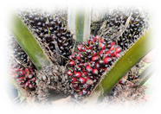
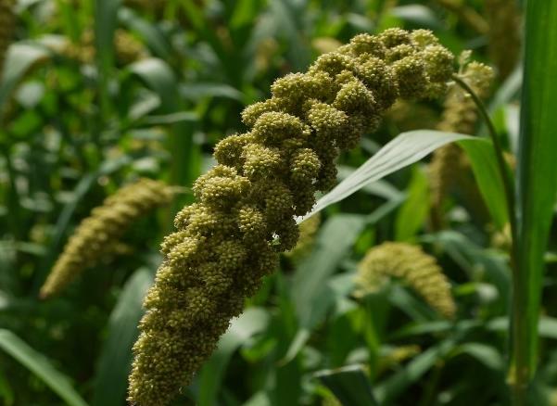
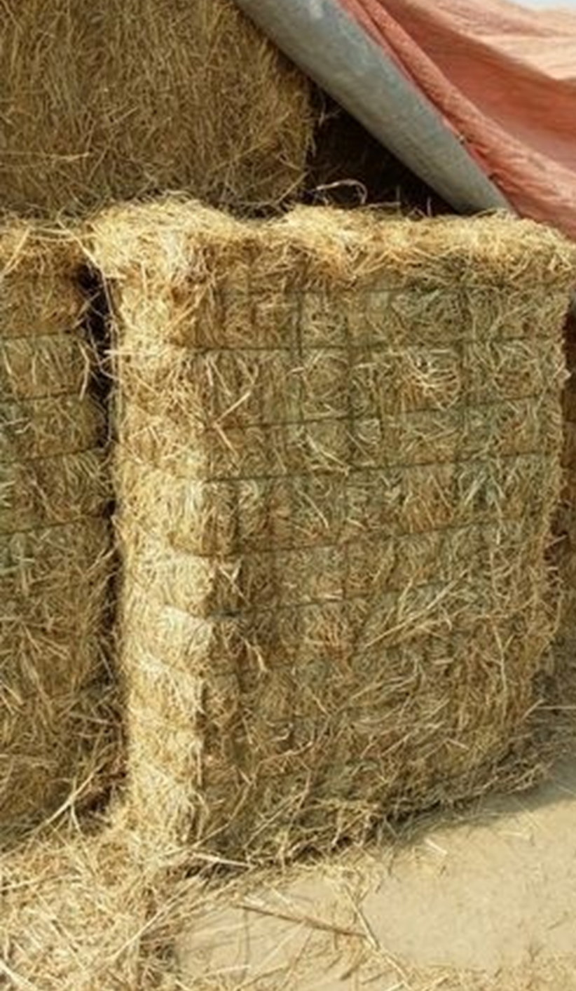
Supportive schemes for Kharif 2022-23
National Food Security Mission (NFSM)
Rashtriya Krishi Vikash Yojana(RKVY)
National Mission on Edible Oils-Oil Palm (NMEO-OP)
Assam Millet Mission(AMM)
Assam Fodder Mini Mission(AFMM)
DEPARTMENT OF AGRICULTURE, ASSAM
8

Slide 9
Kharif Plan
2022-23
(Tentative)
 |  | Area To be Covered (Ha)
SL | CROP | RKVY | NFSM | TOTAL
1 | HYV Paddy | 10000 | 10000 | 20000
2 | Hybrid Paddy | 6000 | 6000 | 12000
3 | Traditional Rice | 10000 | 1800 | 11800
4 | Maize | 26000 | 9000 | 35000
5 | Bio fortified Maize | 15000 | 1000 | 16000
A | Total Cereals | 67000 | 27800 | 94800
1 | Groundnut | 5000 | 2800 | 7800
2 | Sunflower | 1250 | 2000 | 3250
B | Total OilSeeds | 6250 | 4800 | 11050
1 | Balckgrma | 1000 | 9000 | 10000
2 | Greengram | 1000 | 5000 | 6000
3 | Soybean | 2500 | 0 | 2500
C | Total Pulse | 4500 | 14000 | 18500
D | Cash Crop (Jute) | 33000 | 1500 | 34500
E | Nutri cereal (Millets) | 20000 | 1200 | 21200
Area To be covered under demonstration (Ha) |  | 130750 | 49300 | 180050
+ Apart from demonstrations, subsidized seed distribution program will also be undertaken under NFSM to support the farmers in Kharif. (Approx 1.00 lakh Qts)
DEPARTMENT OF AGRICULTURE, ASSAM
9

Slide 10
Kharif Plan
2022-23
(Tentative)
Government of Assam has recently undertaken two special schemes - Assam Millet Mission & Assam Fodder Mini Mission – To be launched this Kharif.
To support the Farm Mechanization, sufficient pre & post-harvest machinery have been planned to distribute amongst the farmers in subsidy.
Major farm machinery are- Power tiller, Solar, Electrical & Diesel STWs, LLPs, Rotavator, Paddy Transplanter, Wheel hoe, Paddy thresher, Pulverizer, Maize sheller, Reaper, Millet dehusker, Winnower etc.
All farm machineries will be distributed through a dedicated Farm Machinery Portal- https://agrimacassam.in
Under NMEO-OP, Major task is to setup another 6 nurseries & 10 seed gardens within Kharif.
The total target of Area Expansion under oil palm in 2022-23 is 4000 Ha (including 1500 Ha of 2021-22). Thrust will be given to complete atleat 50 % during Kharif 2022-23, subject to availability of seedlings.
DEPARTMENT OF AGRICULTURE, ASSAM
10

Slide 11
Preparedness
for Kharif
2022-23
State Level Project Screening Committee (SLPSC) meeting for RKVY conducted. Expected to conduct State Level Sanctioning Committee (SLSC) meeting within 1st week of May.
Allocation for NFSM 2022-23 received. AAP for 2022-23 is in the Final Stage. Expected to conduct State Food Security Mission Executive Committee (SFSMEC) meeting within 15th May.
Procedure for seed procurement as per State Procurement Norms completed.
Active involvement of SAU/KVKs ensured.
Implementing support in grassroots (AEA, ATM/BTM, ADOs etc.) are in place.

Slide 12

Discussion
THANK YOU
DEPARTMENT OF AGRICULTURE, ASSAM

